Slide 1
University Grade & Attendance System
A Java class project built on course modules 1 to 3
1
2
3
4
5
Abstract
Pros & Cons
Implementation
Output
Conclusion
M.Haasini-2620030081
B.Aviyah-2620030112

Slide 2
1
ABSTRACT
Abstract
A console-based Java application that manages student marks and attendance for a university course. It calculates each student’s average, assigns a letter grade and flags attendance below 75%. It applies the first three course modules: problem solving and Java fundamentals, control flow, and methods with recursion and arrays.
Input
Process
Output
→
→
Marks and attendance entered
Average, grade and shortage computed
Grades and shortage list printed

Slide 3
2
ADVANTAGES
Advantages
Advantages
Determines attendance eligibility.
Calculates overall academic performance.
Allows searching for subjects.
Reduces manual calculations.
Uses modular programming through methods.
Automates grade and percentage calculation
Flags low attendance instantly
Results shown as a clear formatted report
Methods keep the code modular and reusable

Slide 4
3
IMPLEMENTATION | MODULE 1
From Problem to Program
Problem: record marks and attendance, then report a grade and eligibility
Plan first with an algorithm and a flowchart
Primitive types: int marks, double average, char grade, boolean present
Constant MIN_ATT; Scanner reads input; printf formats the report
static final int MIN_ATT = 75;
Scanner sc = new Scanner(System.in);
int n = sc.nextInt();
double p = attended * 100.0 / total;
System.out.printf("%.1f%%%n", p);

Slide 5
3
IMPLEMENTATION | MODULE 2
Control Flow
if-else-if ladder in grade() converts the average to A-F
switch with default in remark() gives the remark
for, while and do-while loops read and process every student
break and continue in the roll search; nested-if decides eligibility
if (a >= 90) return 'A';
else if (a >= 75) return 'B';
else if (a >= 60) return 'C';
else if (a >= 40) return 'D';
else return 'F';
switch (g) {
case 'A': return "Excellent";
default: return "Fail";
}

Slide 6
3
IMPLEMENTATION | MODULE 3
Methods, Recursion & Arrays
Methods with return values: sum(), avg(), pct(), grade(), remark()
Overloading: pct(int, int) and pct(boolean[])
Recursion: sum() has a base case and a recursive case
Arrays: roll[], marks[][], present[][]; traversal, search, counting
static int sum(int[] m, int n) {
return n == 0 ? 0
: m[n - 1] + sum(m, n - 1);
}
int[][] marks = new int[n][SUBJECTS];

Slide 7
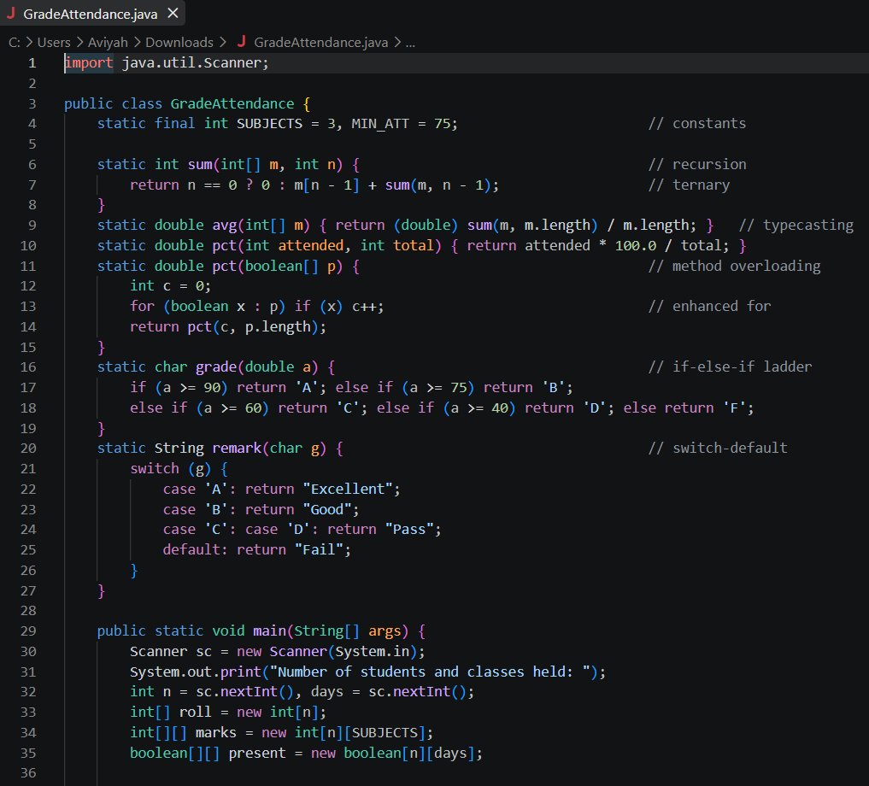
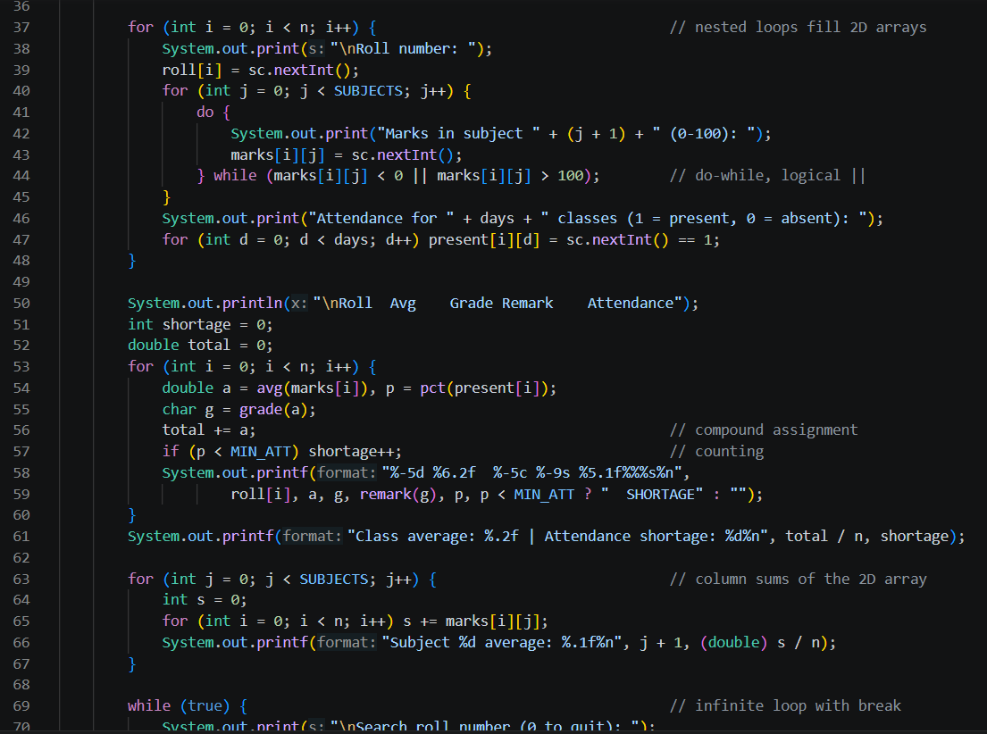
3
IMPLEMENTATION | FULL CODE
Full Code (1 of 2)

Slide 8
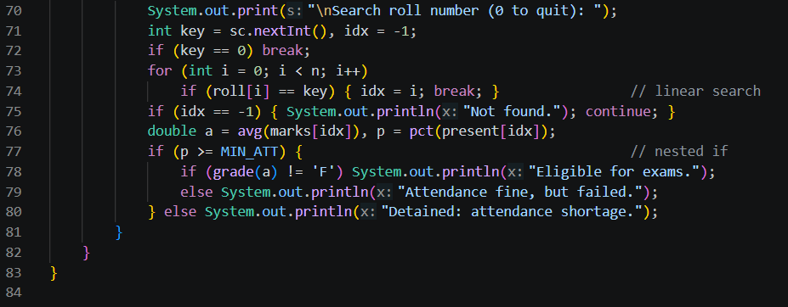
3
IMPLEMENTATION | FULL CODE
Full Code (2 of 2)

Slide 9
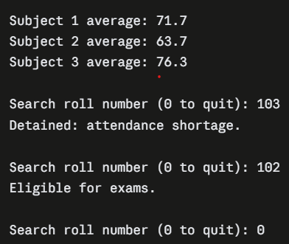
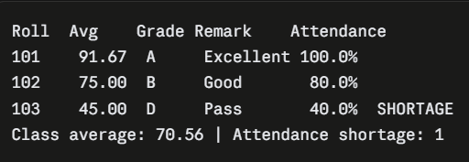
4
OUTPUT
Output Screenshots
Screenshot 1: Grade report
Screenshot 2: Class summary and roll search

Slide 10
5
CONCLUSION & FUTURE WORK
Conclusion & Future Work
The system replaces manual grade and attendance registers with one program that computes results consistently and flags attendance problems early. Building it applied the first three modules of the course in a single working program.
Future work
Classes and file storage using OOP and file I/O
Graphical interface with JavaFX or Swing
Database storage using JDBC
Login roles for faculty and students
Email alerts for attendance shortage

